Slide 1
Why the Common Core?: How these Standards are Different
Presenter: Hallie Hundemer-Booth
Student Achievement Partners

Slide 2
ELA/Literacy: 3 shifts
Building knowledge through content-rich nonfiction
Reading, writing, and speaking grounded in evidence from text, both literary and informational
Regular practice with complex text and its academic language

Slide 3
Non-Examples and Examples
Not Text-Dependent
Text-Dependent
In the article “Global Warming” why do you think they used the picture of the polar bear?
Why is global warming a problem?
The article “Global Warming” they discuss greenhouse gases. What are greenhouse gases?
After reading the article “Global Warming” explain how the polar bear picture is representation of the concept of global warming?
What changes in the Earth’s ecosystem are directly effected by global warming and how do these changes interact with each other to alter the overall ecosystem?
How does human activity effect greenhouse gases and in turn effect overall global warming?

Slide 4
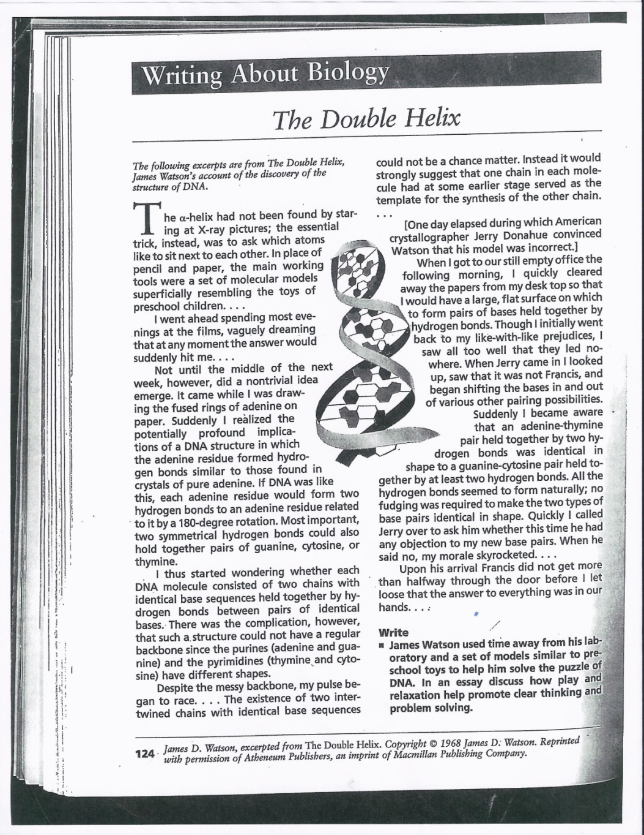
Example?
James Watson used time away from his laboratory and a set of models similar to preschool toys to help him solve the puzzle of DNA. In an essay discuss how play and relaxation help promote clear thinking and problem solving.

Slide 5
Determining Text Complexity

Slide 6
Which text is more complex?
Text 1
Text 2
Centripetal force and centrifugal force, action-reaction force pair associated with circular motion. According to Newton's first law of motion, a moving body travels along a straight path with constant speed (i.e., has constant velocity) unless it is acted on by an outside force. For circular motion to occur there must be a constant force acting on a body, pushing it toward the center of the circular path. This force is the centripetal (center-seeking) force. For a planet orbiting the sun, the force is gravitational; for an object twirled on a string, the force is mechanical; for an electron orbiting an atom, it is electrical. The magnitude F of the centripetal force is equal to the mass m of the body times its velocity squared v 2 divided by the radius r of its path: F=mv2/r. According to Newton's third law of motion, for every action there is an equal and opposite reaction. The centripetal force, the action, is balanced by a reaction force, the centrifugal (center-fleeing) force. The two forces are equal in magnitude and opposite in direction. The centrifugal force does not act on the body in motion; the only force acting on the body in motion is the centripetal force. The centrifugal force acts on the source of the centripetal force to displace it radially from the center of the path. Thus, in twirling a mass on a string, the centripetal force transmitted by the string pulls in on the mass to keep it in its circular path, while the centrifugal force transmitted by the string pulls outward on its point of attachment at the center of the path.
HAVE you ever let the words “centrifugal force” escape from your lips? Shame on you: you might as well have called it the “hocus-pocus force”. You are in good company, though. Scientists, engineers and, we confess, even New Scientist, sometimes let the c-word slip. Why can't we help ourselves? It's all down to our subjective experience getting on top of our scientific judgment. Drive round a curve too fast and you feel as if you're being flung outwards. Turn right sharply, and your sunglasses slide off to the left along the dashboard. And if you enjoy fairground rides you will know that on the “sticky wall” you end up pinned against the inside of a vertical spinning drum as the floor drops away. So, intuition aside, what's really going on? It's all down to Isaac Newton's laws of motion. Stationary objects, Newton pointed out, stay put, and moving objects travel forever with the same velocity unless some force acts on them. As you round a bend, you may feel you are being flung outwards but in reality you are just trying to go straight on. Indeed, if you were pushed out of the car, gangster-movie style, while Newton hovered overhead in a police helicopter, he would see you continue in a straight line until you hit the ground. What we should be talking about here is centripetal rather than centrifugal force. This name comes from the Latin words meaning “centre” and “seeking”. The centripetal force is what makes objects move in a circle. Our notional car, planes looping-the-loop, even planets moving around the Sun — they would all simply fly of at a tangent were it not for the force's inward pull.

Slide 7
What are the Qualitative Features of Complex Text?
Subtle and/or frequent transitions
Multiple and/or subtle themes and purposes
Density of information
Unfamiliar settings, topics or events
Lack of repetition, overlap or similarity in words and sentences
Complex sentences
Uncommon vocabulary
Lack of words, sentences or paragraphs that review or pull things together for the student
Longer paragraphs
Any text structure which is less narrative and/or mixes structures

Slide 8
Where Am I Going?
Provide students with clear and understandable vision of the learning target
R. Stiggins, J. Arter, J. Chappuis, & S. Chappius (2006) Classroom Assessment for Student Learning. ETS. Portland, OR.
Notes:
R. Stiggins, J. Arter, J. Chappuis, & S. Chappius (2006) Classroom Assessment for Student Learning. ETS. Portland, OR.

Slide 9
SMELL TEST - John McManus
S stands for Source. Who is providing the information? M is for Motivation. Why are they telling me this? E represents Evidence. What evidence is provided for generalizations? L is for Logic. Do the facts logically compel the conclusions? L is for Left out. What’s missing that might change our interpretation of the information?

Slide 10
SMELL the Articles
Critical Consumer Test:
Complete the SMELL test for the following articles and be ready to share out your feelings on which you would use in your class and why.
http://climate.nasa.gov/news/1091/
http://en.wikipedia.org/wiki/Global_warming

Slide 11
Clear Learning Target
If the learning is unclear to you then
You will not be able to make it clear to students.
It will be unclear what to teach and how to assess.
It could be interpreted different ways that could lead to significantly different learning experiences.
Create learning targets that are inherent to the intent of the standard.
Sometimes the benchmark or standard is stated in a manner that is clear and may only need to be categorized to determine which method should be used to assess the intended learning.

Slide 12
Rules of Thumb for Deconstruction of Standards
1. Deconstruction of a standard should occur only when it makes the standard clearer- but sometimes you don’t know that until you try to deconstruct it.
2. There are no “product‟ targets/standards for reading. “Product‟ target/standards in mathematics require students to produce a concrete tangible item; a simple sketch/drawing is not math product.
3. Phonics targets are typically knowledge targets. Mathematical procedures where students follow memorized rules or algorithms are knowledge targets because they only require procedural knowledge.

Slide 13
Rules of Thumb for Deconstruction of Standards
4. The only “performance skill‟ in reading involves reading aloud, where the only way you could have evidence of attainment of the standard is to LISTEN to students. Everything else in reading is either knowledge or reasoning. The only “performance skills” in mathematics include standards where you would actually have to OBSERVE students so you can SEE or HEAR them to know if they mastered the target.
5. A product target will not always have an accompanying performance skill target. Product targets sometimes produce evidence of target attainment that do not require a “direct observation‟ of performance. (i.e., using the writing process to complete an assigned piece of writing). Teachers do not always need to SEE or HEAR the students drafting their ideas. The finished product will provide the evidence.

Slide 14
Rules of Thumb for Deconstruction of Standards
6. Performance skill and product targets assure that educators do not “scan tron their way through life.” The “screener” for determining whether or not a standard is a performance skill or product target is that it cannot be assessed accurately using selected response or extended response assessment items. Performance skill targets and product targets require observations, “other‟ assessments, or specific products (that would be beyond any typical extended written response) that focus on degrees of QUALITY, not just right or wrong.
7. Don’t belittle the knowledge category – knowledge does not equal “easy or simple”. Knowledge includes procedural knowledge-- KNOWS HOW, as well as KNOWS THAT and KNOWS WHEN. (ex: tying your shoe begins as a skill, but becomes procedural knowledge once you have mastered it).

Slide 15
Rules of Thumb for Deconstruction of Standards
8. Product vs. Learning Task: Some standards may seem to imply that a “product” is called for when in fact WE impose a notion of HOW we would teach or look for mastery of the target (assess). In that case, the standard probably doesn't have an underpinning product target. Be sure when you are deconstructing standards that the FOCUS is on the learning intended– and not the instructional lesson or activity you would design.
9. Comprehension, just like understands, is a FUZZY term (i.e., different people interpret it in different ways). If you use that word in a target, it needs to be more clearly defined.
10. The ultimate reasons we categorize standards/targets include:
a. To reflect the true cognitive demand needed
b. To inform the best (valid and efficient) assessment method for gathering defensible evidence of student attainment

Slide 16
Types of Learning Targets
Knowledge | Reasoning | Performance Skills | Product
What knowledge or understanding is required to become competent on this standard? | What reasoning (if any) is required to be competent on this standard? | What performance skills (if any) are required to demonstrate competence on this standard? | What product competencies (if any) are required by this standard?
Remember, not all standards have all of these as underpinnings and some standards may only need to be ‘classified’ to assist with assessing students’ learning.
Notes:
Explain, Know, Describe could be Knowledge or Reasoning – need to be crystal clear when using these verbs. “Understand” needs more clarity and should not stand alone.

Slide 17
Cognitive Scaffolding and Targets
Knowledge
Reasoning
Performance Skills
Products

Slide 18
Knowledge
Reasoning
Intent of Performance Expectation
Product
Performance
Skills
Notes:
Targets that collectively work together to develop the intent of the standard -

Slide 19
Example of the work
Performance Expectation
K-PS2-2
How to use:
Activity 4.2
Activity 4.4

Slide 20
Protocols
Activity 4.2
Target – Method Match Template
Take each LT:
Determine what type of Assessment Method would be appropriate for each.

Slide 21
Learning Target Match
While using K-PS2-2 look over the learning targets created in each section and Match the Learning Target with the Target Type and what type of assessment could be used to assess that target.
Evaluate the number of each type of assessment used.
Note: You could check more than one assessment type .

Slide 22
Types of Assessments
Selected Response
Multiple choice
Extended Written Response
Performance
Personal Communication
Anecdotal notes from verbal discussion with student

Slide 23
Assessment – Learning Target Match
Take the assessments given to you and match each question or activity to the correct Learning Target assessed (could possibly be more than one assessed)
What patterns and/or concerns do you see.
What changes would needed to be made with these activities/questions.

Slide 24
Assessment Creation
Once you have examined the LT’s and determined what type of assessment method you should use look for/create the assessment questions.
Once you have selected the questions/activities/extended response use Activity 4.4 Audit an Assessment for Clear Learning Targets to assess what targets are assessed for each question.

Slide 25
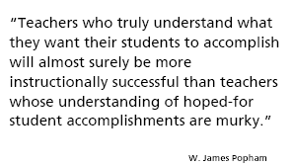

Slide 26
Anyone too busy to reflect on one’s practice is also too busy to improve. Robert Garmston

Slide 27
Your Turn
Find the Standard or PE within your subject that you wish to work with.
Begin to deconstruct the standard/PE using the forms provided
Once the deconstruction of the standard is complete use the Learning Target Match form to check for connection and match.

Slide 28
Kentucky Examples of Math and Language Arts Deconstruction
http://education.ky.gov/curriculum/math/pages/mathematics-deconstructed-standards.aspx
http://education.ky.gov/curriculum/ela/pages/ela-deconstructed-standards.aspx

Slide 29
Share Out
Share comments about the process
Questions/Concerns/Discussions
Next Steps

