Slide 1
Literacy and Science how does it fit?

Slide 2
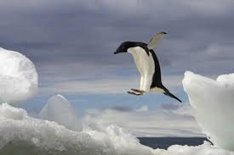
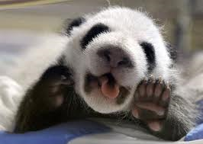
Which one are you?

Slide 5
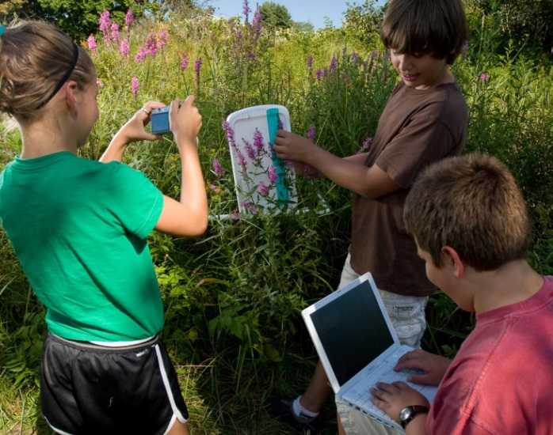
Why discuss literacy?
Researchers have found that students learn science better when they write about their thinking and that the act of writing may force integration of new ideas and relationships with prior knowledge. (Thier and Daviss, 2002)

Slide 6
Shared Responsibility
“The grades 6–12 standards are divided into two sections, one for ELA and the other for history/social studies, science, and technical subjects. This division reflects the unique, time-honored place of ELA teachers in developing students’ literacy skills while at the same time recognizing that teachers in other areas must have a role in this development as well.”
.

Slide 10
Literacy and Subjects
No more guess work…subject standards include the literacy connection but additional connections can be made further.
Know how to interpret the literacy part of the standard to show a seamless connection and flow.

Slide 11
Shifts in ELA/Literacy
Building knowledge through content-rich nonfiction
Reading, writing and speaking grounded in evidence from text, both literary and informational
Regular practice with complex text and its academic language

Slide 12
Shift #1: Building Knowledge Through Content-Rich Nonfiction

Slide 13
Building Knowledge Through Content-rich Nonfiction – Why?
Students are required to read very little informational text in elementary and middle school.
Non-fiction makes up the vast majority of required reading in college/workplace.
Informational text is harder for students to comprehend than narrative text.
Supports students learning how to read different types of informational text.

Slide 14
Distribution of Literacy and Informational Texts

Slide 15
All Teachers Support Literacy
This interdisciplinary approach to literacy stems from extensive research establishing the need for college and career ready students to be proficient in reading complex informational texts, independently, in a variety of content areas.
Most of the required reading in college and workforce training programs is informational in structure and challenging in content
Postsecondary education programs typically provide students with both a higher volume of such reading than is generally required in K–12 schools and comparatively little scaffolding.
The 2009 reading framework of the National Assessment of Educational Progress (NAEP) requires a high and increasing proportion of informational text on its assessment as students advance through the grades.

Slide 19
Shift #2: Reading, Writing and Speaking Grounded in Evidence From Text, Both Literary and Informational

Slide 20
Reading, Writing and Speaking Grounded in Evidence from Text: Why?
Most college and workplace writing requires evidence.
Evidence is a major emphasis of the ELA Standards: Reading Standard 1, Writing Standard 9, Speaking and Listening standards 2, 3 and 4, all focus on the gathering, evaluating and presenting of evidence from text.
Ability to cite evidence differentiates strong from weak student performance on NAEP.
Being able to locate and deploy evidence are hallmarks of strong readers and writers.

Slide 21
Shift #3:Regular Practice with Complex Text and Its Academic Language

Slide 22
Regular Practice With Complex text and Its Academic Language: Why?
Gap between complexity of college and high school texts is huge.
What students can read, in terms of complexity, is greatest predictor of success in college ( 2006 ACT study).
Too many students are reading at too low a level.
Standards include a staircase of increasing text complexity from elementary through high school.
Standards also focus on building general academic vocabulary so critical to comprehension.

Slide 23
Shifts in ELA/Literacy
Building knowledge through content-rich nonfiction
Reading, writing and speaking grounded in evidence from text, both literary and informational
Regular practice with complex text and its academic language

Slide 24
Practices in Science, Mathematics, and English Language Arts (ELA)

Slide 25
Practices in Math, Science, and ELA*
Practices in Mathematics, Science, and English Language Arts*
Math | Science | English Language Arts
M1. Make sense of problems and persevere in solving them. M2. Reason abstractly and quantitatively. M3. Construct viable arguments and critique the reasoning of others. M4. Model with mathematics. M5. Use appropriate tools strategically. M6. Attend to precision. M7. Look for and make use of structure. M8. Look for and express regularity in repeated reasoning. | S1. Asking questions (for science) and defining problems (for engineering). S2. Developing and using models. S3. Planning and carrying out investigations. S4. Analyzing and interpreting data. S5. Using mathematics, information and computer technology, and computational thinking. S6. Constructing explanations (for science) and designing solutions (for engineering). S7. Engaging in argument from evidence. S8. Obtaining, evaluating, and communicating information. | E1. They demonstrate independence. E2. They build strong content knowledge. E3. They respond to the varying demands of audience, task, purpose, and discipline. E4. They comprehend as well as critique. E5. They value evidence. E6. They use technology and digital media strategically and capably. E7. They come to understanding other perspectives and cultures.
* English Language Arts uses the term “student capacities” rather than the term “practices” used Mathematics and the Next Generation Science Standards.

Slide 26
Math
Science
M4. Models with mathematics
S2: Develop & use models
S5: Use mathematics & computational thinking
M1: Make sense of problems and persevere in solving them
M2: Reason abstractly & quantitatively
M6: Attend to precision
M7: Look for & make use of structure
M8: Look for & make use of regularity in repeated reasoning
S1: Ask questions and define problems
S3: Plan & carry out investigations
S4: Analyze & interpret data
S6: Construct explanations & design solutions
E2: Build a strong base of knowledge through content rich texts
E5: Read, write, and speak grounded in evidence
M3 & E4: Construct viable arguments and critique reasoning of others
S7: Engage in argument from evidence
E6: Use technology & digital media strategically & capably
M5: Use appropriate tools strategically
S8: Obtain, evaluate, & communicate information
E3: Obtain, synthesize, and report findings clearly and effectively in response to task and purpose
Commonalities
Among the Practices in Science, Mathematics and English Language Arts
E1: Demonstrate independence in reading complex texts, and writing and speaking about them
E7: Come to understand other perspectives and cultures through reading, listening, and collaborations
Based on work
by Tina Chuek
ell.stanford.edu
ELA

Slide 27
What does this mean in regard to instruction in the classroom
Students will have to read complex text.
Research ideas and topics for classroom discussion and experimentation.
Be able to argue their point and back up their statements with specific information from research and hands on activities.
Constantly be reading, writing, speaking and creating in the science classroom.

Slide 28
Examples of Literacy (video)
Take notes on the students and teachers discussions/actions.
How would this be helpful in your classroom and how easy would the above be to implement.

Slide 29
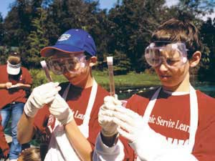
Science and language are interdependent. Their processes are mirrored in each other.
Students at all levels should be able to:
Note details
Compare and contrast
Predict
Sequence events
Link cause and effect
Distinguish fact from opinion
Link words with precise meanings
Make inferences
Draw conclusions
From Thier and Daviss, 2002

Slide 30
Strategies to improve literacy in science. Use prompts to uncover ideas.
Predicting: What does the topic title reveal?
Reflective questioning before reading: What does this topic mean to me?
Reflective questioning after reading: What questions do I still have about this topic?
Evaluating: What it is the main idea of this reading?
Paraphrasing: Turn and talk with a classmate about the reading.
Summarizing: How many key ideas can I identify?
Identifying words and meanings: Do I understand the meaning of the reading?
Reflecting on the overall reading: If I reread this topic, what areas would I focus on?

Slide 31
Expectations
A successful 21st century student must :
Be able to read material that is age/grade appropriate
Decipher readings that are challenging
Make arguments and present claims
Be able to write fluidly and with clarity
Be able to pull information needed from text and research materials
Problem solve using pervious knowledge and research to back their position up.
(science specific – be able to create their experimental design, complete the experiment and conclude the findings in a detailed, factual based format.

Slide 32
Scavenger hunt through the PE’s
Look at the PE you are given.
Locate where the literacy connection is located
Note where the literacy connection is listed within the PE
Develop a plan that will allow you to address the PE and incorporate the literacy piece within the lessons.

Slide 33
Shout out
Share with the other participants your ideas of how you are going to incorporate literacy into your lessons.
If you have any suggestions or comments please ask and send them via the message board to be addressed. – remember we are in the learning process and part of that process if “collaboration” and suggestions to make our lessons stronger. We can not take offense to others ideas and/or questions.

Slide 34
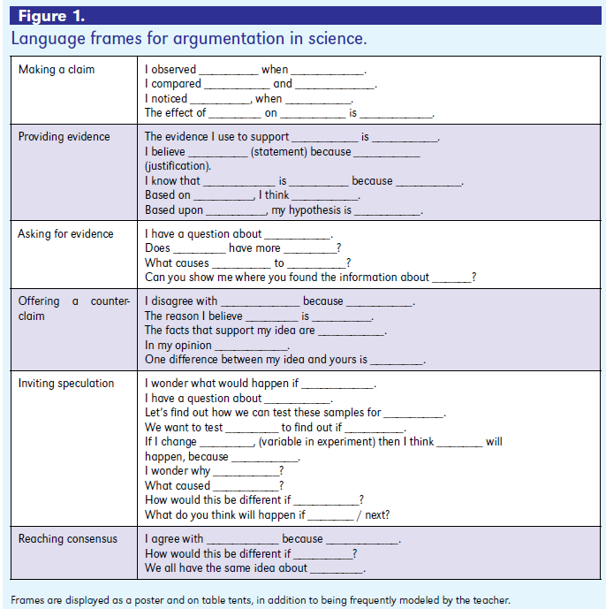
The Art of Argumentation
Ross, Fisher and Frey
Science and Children, 2009, p.29

Slide 35
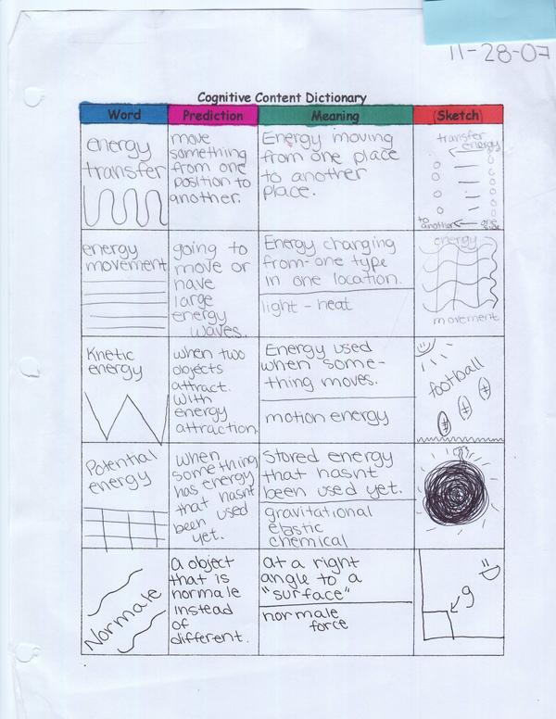
Interactive Notebooks
http://www.sciencenotebooks.org/

Slide 36
What can go on the left side of an interactive notebook?
Brainstorming
Discovery headlines
Biography posters
Concept maps
Riddles
Your questions
Pictographs
Cartoons
Poetry and songs
Significant statements
Flowcharts
Graphic organizers
Drawings
Metaphors and analogies
Venn diagrams
Bulls-Eye diagrams
Data and graphs you generate
Analysis writing
Reflection writing
Quick-writes
Four square analogies
Mnemonics
Writing prompts
Scientific conclusions
Other creative avenues for
processing information
All sorts of student work!!!

Slide 37
What goes on the right side of an interactive notebook?
Student generated question | Factual Information
Why are plants green instead of blue or red? How does photosynthesis work to make food? | Scientists note that plants are green. Many hypotheses have been proposed to understand plant color. ….. Plants…..
Summary Photosynthesis is a process…..
The Cornell note style helps students think reflectively about
a topic, generate questions, which the teacher can facilitate
during instruction.
http://teacher.ocps.net/susan.colwell/media/inbinsertsv3.pdf

Slide 44
Some resources
http://www.scienceandliteracy.org/teachersupport/strategyguides
http://score.rims.k12.ca.us/teachers/contentliteracy/
http://www.learninga-z.com/commoncore/close-reading.html
http://www.aspendrl.org/portal/browse/DocumentDetail?documentId=1396&download
http://www.tennessee.gov/education/ci/english/doc/READ_Gr_6-8_Content_Area.pdf

Slide 45
Discussion and Wrap Up
Discuss questions and answers from the day
Needed support from me

